Slide 1
Final Project Sako Kassabian
Can we get ahead of “problem” students?

Slide 2
Education has an information problem
Schools have a ton of data
They have no idea what to do with it
It’s actually a lot of industries
It’s all done after the fact with reports
Aggregate level
Data must lead to information that leads to action

Slide 3
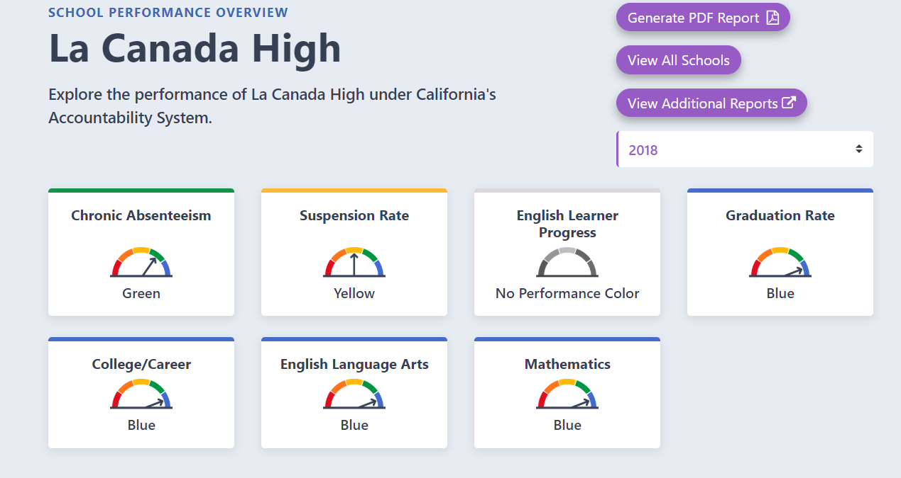
Example of after the fact reports
Caschooldashboard.com

Slide 4
Data maturity in an organization
Can’t eat steak as a baby
Executive leadership
We need analytics
We need machine learning
Rise of black box tech companies

Slide 5
Where does the data maturity journey begin?
Consulting
Education for the educators
See where they are and tailor a solution
Data cannot do their job for them
It is a tool, not a master
Not a silver bullet
Limitations

Slide 6
Getting in front of “In Danger” students
With data, no child slips through the cracks
Focus your already stretched personnel
Delve into the depths of aggregate reports

Slide 7
Predicting “In Danger” students
What is In Danger?
Converted a grade score to binary feature
If student English grade = D or F
Field = 1, else = 0

Slide 8
Full Dataset
Grade level
E1, E2, E3
English standardized test scores for last 3 years
Absent rate
ELA (English Learning Acquisition) Status
Race

Slide 9
Feature Engineering
English Grades conversion
A – F
-/+ grouped together
Into 1-5, else 0
ELA (English Learning Acquisition) Status
One hot encoded via pd.get_dummies
EO, EL, IFEP, RFEP
Race
One hot encoded via pd.get_dummies

Slide 10
Feature Engineering Cont.
Square
Log
Square root

Slide 11
Models
Logistic Regression
Random Forest
SVM
Models are ~90% accurate
The journey was tough – needed to overcome overfitting issues
Still struggling with specificity – more data required
Mixed-effect model
Intraclass correlation of .78

Slide 12
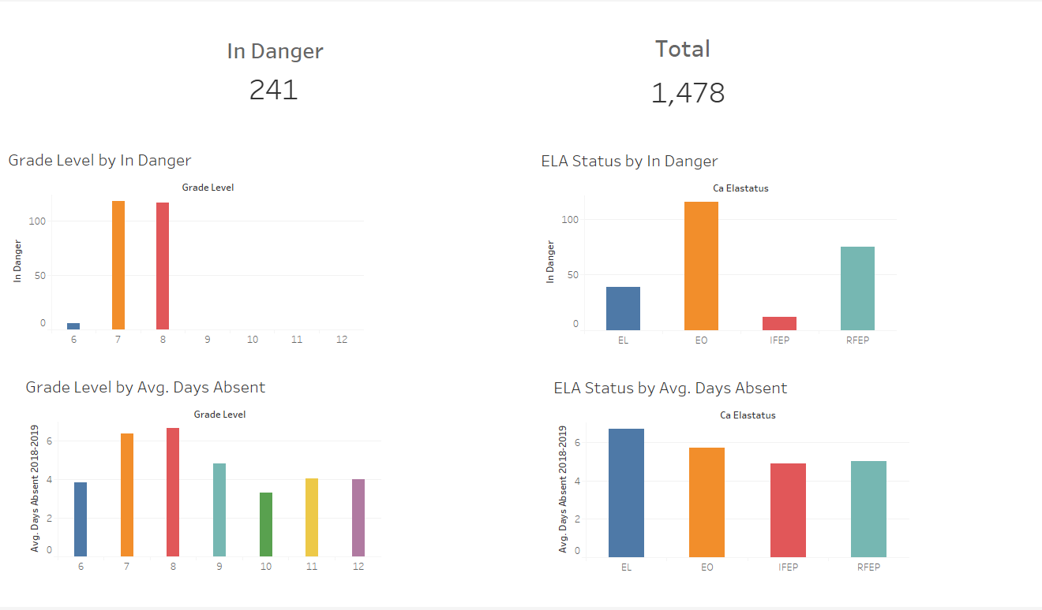
Final Output
A dashboard that has a portion of your In Danger students
Along with segmented data information where you have the ability to drill down and view those students

Slide 13
Final Product – Models in Production
Azure? Report?
Delivery structure

